Slide 1
Numerical Methods
Topic 1:
Introduction to Numerical Methods and Taylor Series

Slide 2
Lecture 1
Introduction to Numerical Methods
What are NUMERICAL METHODS?
Why do we need them?

Slide 3
Numerical Methods
Numerical Methods:
Algorithms that are used to obtain numerical solutions of a mathematical problem.
Why do we need them?
1. No analytical solution exists,
2. An analytical solution is difficult to obtain
or not practical.

Slide 4
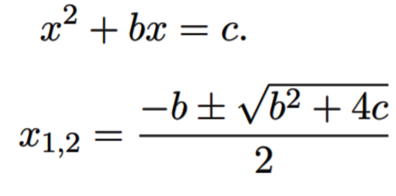
Solving quadratic equation using analytic method:

Slide 5
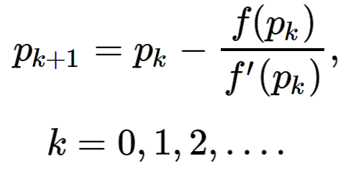
Solving quadratic equation using Numerical method:

Slide 6
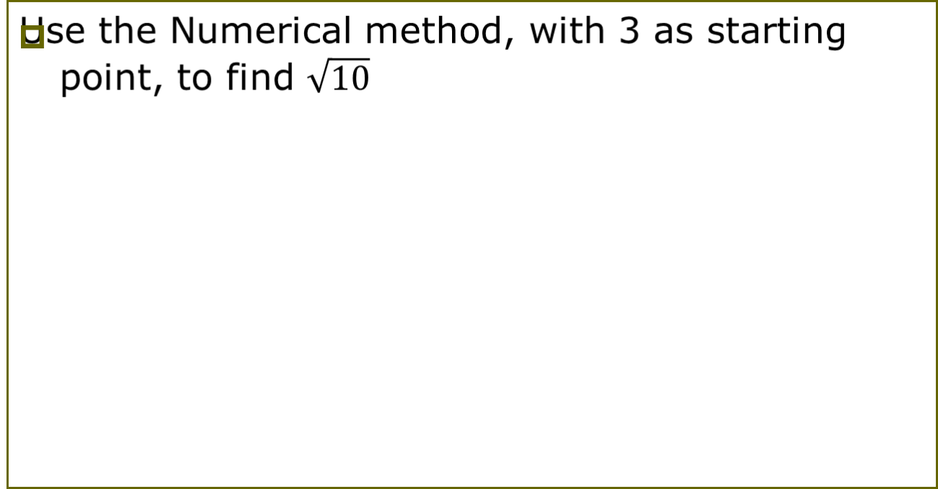
Solving quadratic equation using Numerical method:

Slide 7
What do we need?
Basic Needs in the Numerical Methods:
  Practical:
  Can be computed in a reasonable amount of time.
  Accurate:
    Good approximate to the true value,
    Information about the approximation error (Bounds, error order,… ).

Slide 8
Outlines of the Course
Taylor Theorem
Number Representation
Solution of nonlinear Equations
Interpolation
Numerical Differentiation
Numerical Integration
Solution of linear Equations
Least Squares curve fitting
Solution of ordinary differential equations
Solution of Partial differential equations

Slide 9
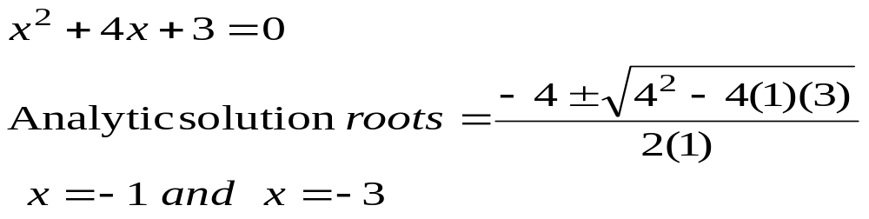
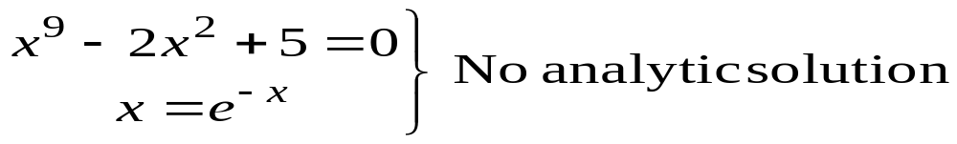
Solution of Nonlinear Equations
Some simple equations can be solved analytically:
Many other equations have no analytical solution:

Slide 10
Methods for Solving Nonlinear Equations
Bisection Method
Newton-Raphson Method
Secant Method

Slide 11
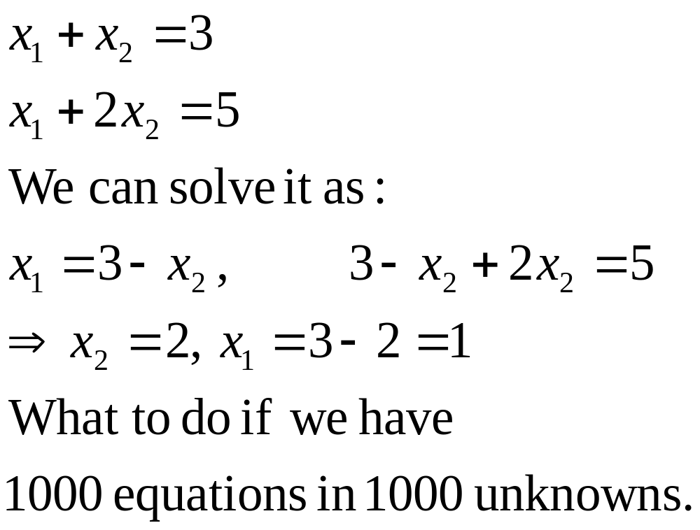
Solution of Systems of Linear Equations

Slide 12
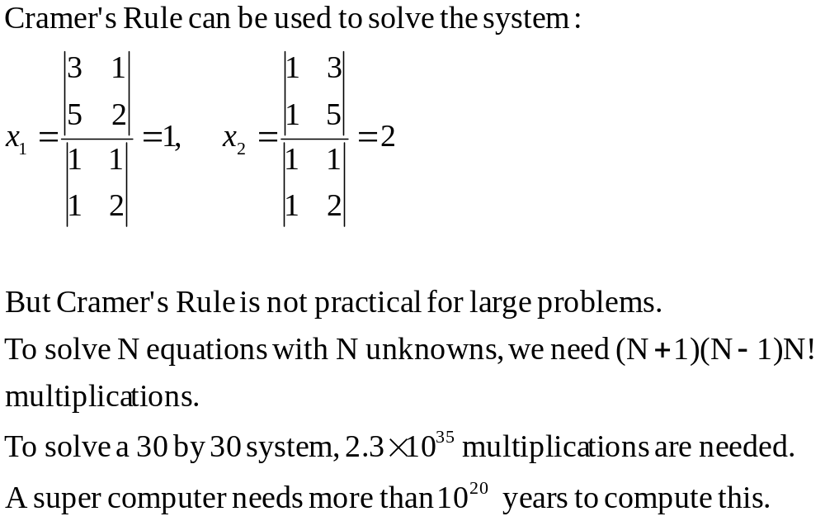
Cramer’s Rule is Not Practical

Slide 13
Methods for Solving Systems of Linear Equations
Naive Gaussian Elimination
Gaussian Elimination with Scaled Partial Pivoting
Algorithm for Tri-diagonal Equations

Slide 14
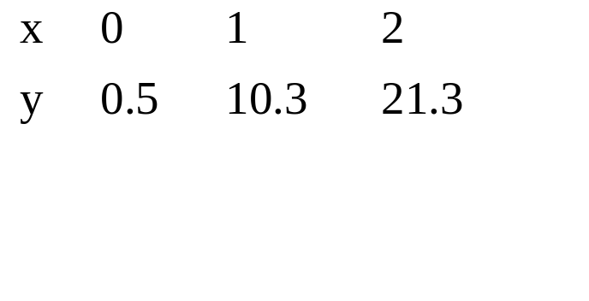
Curve Fitting
Given a set of data:
Select a curve that best fits the data. One choice is to find the curve so that the sum of the square of the error is minimized.

Slide 15

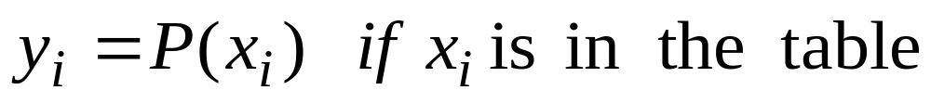
Interpolation
Given a set of data:
Find a polynomial P(x) whose graph passes through all tabulated points.

Slide 16
Methods for Curve Fitting
Least Squares
  Linear Regression
  Nonlinear Least Squares Problems
Interpolation
  Newton Polynomial Interpolation
  Lagrange Interpolation

Slide 17
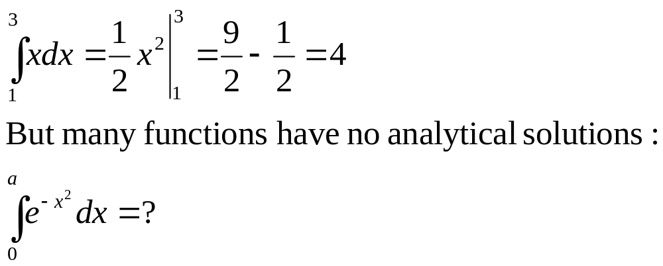
Integration
Some functions can be integrated analytically:

Slide 18
Methods for Numerical Integration
Upper and Lower Sums
Trapezoid Method
Romberg Method
Gauss Quadrature

Slide 19
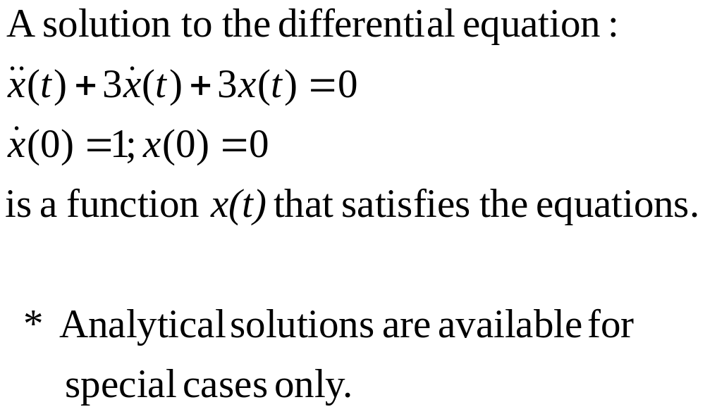
Solution of Ordinary Differential Equations

Slide 20
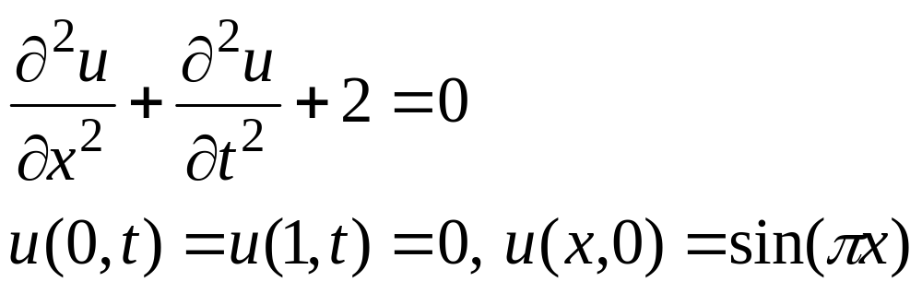
Solution of Partial Differential Equations
Partial Differential Equations are more difficult to solve than ordinary differential equations:

Slide 21
Summary
Numerical Methods:
Algorithms that are used to obtain numerical solution of a mathematical problem.
We need them when
No analytical solution exists or it is difficult to obtain it.
Topics Covered in the Course
Solution of Nonlinear Equations
Solution of Linear Equations
Curve Fitting
  Least Squares
  Interpolation
Numerical Integration
Numerical Differentiation
Solution of Ordinary Differential Equations
Solution of Partial Differential Equations

Slide 22
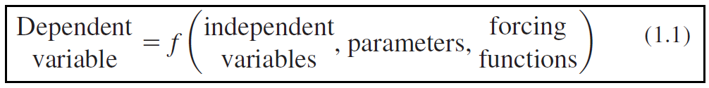
Newton’s 2nd law – a model form
a formulation or equation that expresses the essential features of a physical system or process in mathematical terms. It can be represented as a functional relationship of the form

Slide 23
A SIMPLE MATHEMATICAL MODEL
DV→ a characteristic that usually reflects the behaviour or state of the system;
IV→ are usually dimensions, such as time and space, along which the system’s behaviour is being determined;
Parameters→ are reflective of the system’s properties or composition; and
forcing functions→ external influences acting upon the system

Slide 24
A SIMPLE MATHEMATICAL MODEL
The mathematical expression, or model, of the second law is the well known equation
F = ma (1.2)
F = net force acting on the body (N, or kg m/s2),
m = mass of the object (kg),
a = acceleration (m/s2).

Slide 25
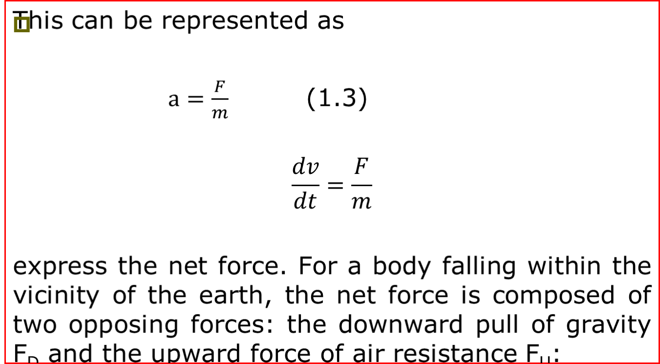
A SIMPLE MATHEMATICAL MODEL

Slide 26
TYPES OF MODELS
Deterministic models
Stochastic models

Slide 27
Steps in modeling
Research problem
Collecting Data
Cleaning Data
Propose the model
Learning the model
Testing the model
Deploy the model if it is good otherwise

Slide 28
Review of Chapter 2 Programing
DO the followings
2.4
2.9
2.18

Slide 29
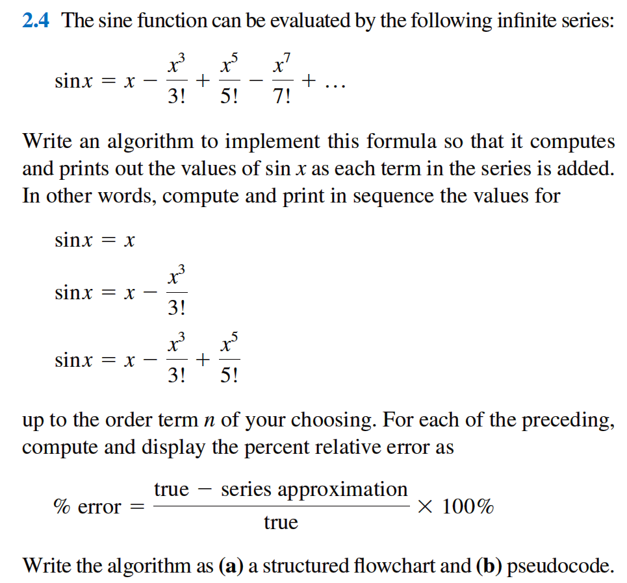

Slide 30
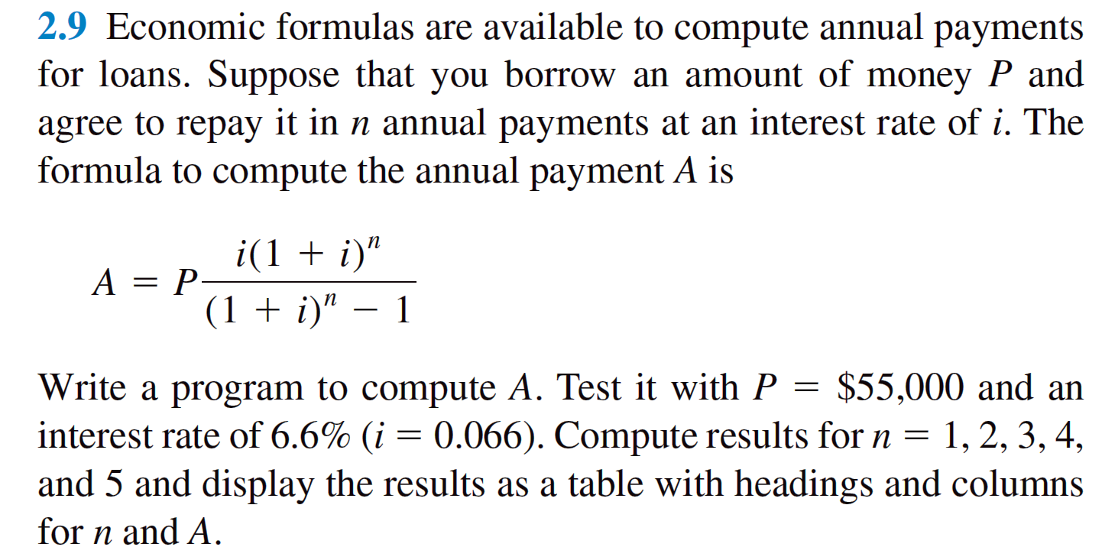
Review of Chapter 2

Slide 31
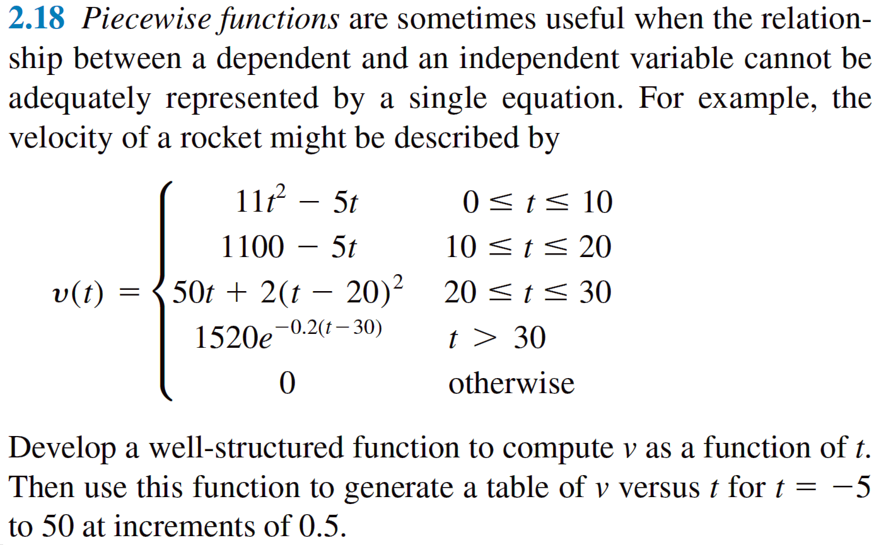
Review of Chapter 2

Slide 32
Questions

